Slide 1
Heap Sort Algorithm
Problem Definition: Implement Heap Sort Algorithm to sort a given set of elements and determine the time required to sort the elements. Plot the graph of Computing V/s Problem size.
CSE@GIT

Slide 2
Objectives of the Experiment:
To apply the Transform and conquer strategy
Present the working of HEAPSORT
3. Learn to write Algorithm in standard form
4. Analyze the Algorithm & Estimate computing time

Slide 3
Theoretical Background of the Experiment
Design strategy – Transform and Conquer
Transform and Conquer algorithm transforms the problem into a new representation so that it easier to solve.
Genaral Idea : it is a Two stage procedures that works as follows:
First stage : It is called as Transformation stage where the problem instance is modified so that it is amenable / open to get a solution.
Second Stage : It is called as Conquer stage where the modified problem instance is solved and becomes the Basis of solution for the original problem.

Slide 4
Basic definition
Binary tree : It is tree data structure consists of a finite set of nodes that is either empty, or consists of one specially designated node called the root of the binary tree, and the elements of two disjoint binary trees called the left sub-tree and right sub-tree of the root.
Depth –The depth of a node is the number of edges from the node to the tree's root node.
Level of a tree - It is depth plus 1
Height of tree : height of a tree would be the height of its root node,or equivalently, the depth of its deepest node.

Slide 5
A complete binary tree
Complete Binary Tree : A Binary Tree of depth d is Almost Complete iff: The tree is Complete Binary Tree (All nodes) till level (d-1). At level d, (i.e the last level), if a Node is present, then all the Nodes to the left of that node should also be present. More precisely it is a binary tree in which every level, except possibly the last, is completely filled, and all nodes are as far as left justified.
Not a Complete Binary Tree
Complete Binary Tree
1
A
2
A
B
B
3
C
5
C
D
E
4
6
7
F
G
D
E
F
G
8
9
H
I
J
K
H
I

Slide 6
Full Binary Tree
A full binary tree is a tree in which every node other than the leaves has two children.
Height 3 full binary tree.

Slide 7
Heaps and Heapsort
Heap sort :
Its an interesting sorting algorithm discovered by J.W.J Williams that sorts an array of numbers in order that array being formatted first as a heap.
It uses Transform and conquer design strategy to sort the elements in increasing order in two stages.
In the First stage array is transformed into a Heap array.
In the second stage the heap array is sorted

Slide 8
Heaps and Heapsort
What is Heap (Max-Heap) ?
A heap is a binary tree with keys at its nodes (one key per node) such that:
1. It is essentially complete, i.e., all its levels are full except possibly the last level, where only some rightmost keys may be missing
2. The value in the node is as large as or larger than the values in its children.

Slide 9
Illustration of the heap’s definition
a heap
not a heap
not a heap
Note: Heap’s elements are ordered top down (along any path down from its root), but they are not ordered left to right

Slide 10
Heap’s Array Representation
Store heap’s elements in an array (whose elements indexed, for convenience, 1 to n) in top-down left-to-right order
Example:
Left child of node j is at 2j
Right child of node j is at 2j+1
Parent of node j is at ⎣j/2⎦
Parental (ie interior) nodes are in the first ⎣n/2⎦ locations
leaf nodes are at locations ⎣n/2⎦+1 to n
i.eThe elements in the subarray A[(⎣n/2⎦+1) .. n] are leaves
9
1 2 3 4 5 6
5
3
9 5 3 1 4 2
1
4
2

Slide 11
Heap sort Procedure
Basic Idea:
Stage -1 - Build a max-heap from the array by calling HeapBottomUp(H[1,n]) procedure.
Stage -2 - Swap the root (the maximum element) with the last element in the array
- “Discard” this last node by decreasing the heap size
- Call HeapBottomUp(H[1,n]) procedure re-build the heap in an array on the new root.
- Repeat this process until only one node remains

Slide 12
Stage-1 Building Max-Heap (bottom-up)
Step 1: Starting with the last (rightmost) parental (ie interior) node, fix the heap rooted at it, if it doesn’t satisfy the heap condition: keep exchanging it with its largest child until the heap condition holds.
Step 2: Repeat Step 1 for the preceding parental node
Note : Bottom up: Adding nodes to heap from bottom to top, pushing elements down, as needed in Step 1 is called Heapify

Slide 13
Example to Building a Heap with Bottom-Up Approach
Convert an array A[1 … n] into a max-heap (n = length[A]) by using bottom-up heap construction - n=10
Apply HEAPIFY on elements between 1 and ⎣n/2⎦- 1 to 5
i.e 5-parent nodes they are 4,1,3,2,16
1
4
2
3
A:
4 | 1 | 3 | 2 | 16 | 9 | 10 | 14 | 8 | 7
1
3
4
5
6
7
2
16
9
10
8
9
10
14
8
7

Slide 14
Example: A
4 | 1 | 3 | 2 | 16 | 9 | 10 | 14 | 8 | 7
i = 5
i = 4
i = 3
1
1
1
4
4
4
2
3
2
3
2
3
1
3
1
3
1
3
4
5
6
7
4
5
6
7
4
5
6
7
2
16
9
10
2
16
9
10
14
16
9
10
8
9
10
8
9
10
8
9
10
14
8
7
14
8
7
2
8
7
i = 2
i = 1
1
1
1
4
4
16
2
3
2
3
2
3
1
10
16
10
14
10
4
5
6
7
4
5
6
7
4
5
6
7
14
16
9
3
14
7
9
3
8
7
9
3
8
9
10
8
9
10
8
9
10
2
8
7
2
8
1
2
4
1

Slide 15
Bottom Up Heap construction
Algorithm HeapBottomUp(H[1,n])
// Construct a heap from the elements of given array by
// the bottom up approach
// Input : An array H[1,n] of orderable items
// Output : A heap array H[1.n]
for i= n/2 downto 1 do
Begin
HeapAdjust(H, i, n) // Call heap adjust procedure to
End // build the heap staring with rightmost
//leaf in the array
Initial call : HeapBottomUp(H[1, n])

Slide 16
Heap adjust algorithm
Algorithm HeapAdjust(H, i, n)
// Construct a heap array by heap bottom up approach
// Input : An array H[1,n] of orderable items
// Output : A heap array H[1.n]
k←i; v ←H[k] // fixing the parent node for rooting the heap
heap ← false
while not heap and 2k ≤ n do
Begin
j ←2*k // left child of parent node being considered for heapify
if j < n // There are two children
if H[j] < H[j+1] j ← j+1 // searching for child with larger value
if v ≥ H[j] // parent node satisfies the heap property
heap ← true
else H[k] ← H[j]; k ← j // move child node at the location of parent’s node
H[k] ← v // move parent node to child’s position to
// Satisfy the heap property

Slide 17
Stage-2 – Swapping the root with last node & rebuilding the Heap Example: A=[7, 4, 3, 1, 2]
HeapAdjust(H, 1, 4)
HeapAdjust(H, 1, 3)
HeapAdjust(H, 1, 2)
HeapAdjust(H, 1, 1)

Slide 18
Example-2 of Sorting by Heapsort
Sort the list 2, 9, 7, 6, 5, 8 by heapsort
Stage 1 (heap construction) Stage 2 (root/max removal)
1 9 7 6 5 8 9 6 8 2 5 7
2 9 8 6 5 7 7 6 8 2 5 | 9
2 9 8 6 5 7 8 6 7 2 5 | 9
9 2 8 6 5 7 5 6 7 2 | 8 9
9 6 8 2 5 7 7 6 5 2 | 8 9
2 6 5 | 7 8 9
6 2 5 | 7 8 9
5 2 | 6 7 8 9
5 2 | 6 7 8 9
2 | 5 6 7 8 9

Slide 19
Heapsort Algorithm
_{Algorithm Heapsort(H[1, n])}
// Sorts a given array by using transform and conquer design strategy
// Input : An array H[1, n] of orderable elements
// Output : An array H[1,n] sorted in non-decreasing order
HeapBottomUp(H,n) // Stage-1 calling procedure to construct heap
_{// for a given array}
for i ←n downto 2 do // Stage -2 root deletion operation n-1 times
_{Begin}
t← H[i] // exchange root’s key with last rightmost key k of the heap
_{H[i] ← H[1]}
_{H[1] ← t}
HeapAdjust(H, 1, i-1) // call heap adjust procedure to rebuild the heap
_{end}
Initial call : HeapBottomUp(H[1, n])

Slide 20
Analysis of Heapsort
Stage 1: Build heap for a given list of n keys (of height h)
worst-case
C(n) =
Stage 2: Repeat operation of root removal n-1 times (fix heap)
worst-case
C(n) = Both worst-case and average-case efficiency: Θ(nlogn)
h-1
Σ
2(h-i) 2^{i} = 2 ( n – log₂(n + 1)) ∈ Θ(n)
i=0
# nodes at level i
n-1
Σ
2log₂ i ∈ Θ(nlogn)
i=1

Slide 21
Comparison with Quick Sort and Merge Sort
Heapsort is always O(n log n)
Quicksort is usually O(n log n) but in the worst case slows to O(n²)
Quicksort is generally faster, but Heapsort is better in time-critical applications.
However, merge sort is simpler to understand than heap sort, is a stable sort, can be easily adapted to operate on linked lists and very large lists stored on slow-to-access media such as disk storage or network attached storage.
Heap sort shares none of these benefits; in particular, it relies strongly on random access.

Slide 22
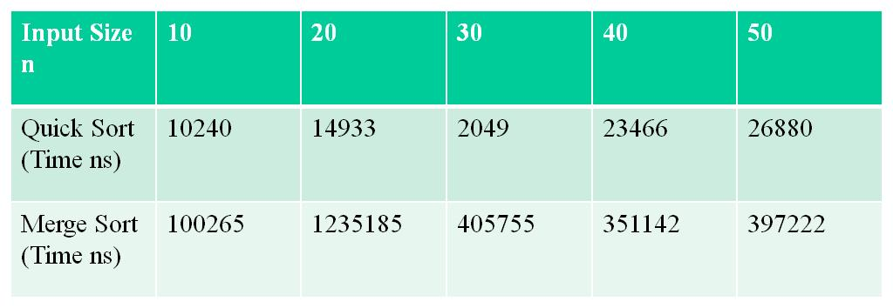
Computation Time for Different Size of Input
Input Size n | 10 | 20 | 30 | 40 | 50
 | 12249 | 22048 | 23798 | 29397 | 87141

Slide 23
Time and Space Complexity
N ²
→ BubbleSort
T(N)
N*logN → HeapSort
N

Slide 24
Illustration of the Heap Sort
Animated video https://www.youtube.com/watch?v=onlhnHpGgC4

Slide 25
Learning Outcome of the Experiment and Conclusion
At the end of the session, students should be able to :
Explain the working of Transform and Conquer Strategy [L2, CO 2, PO1]
Demonstrate the working of Heapsort algorithm on a given set of size n
[L3, CO 2, PO3]
Estimate the computing time using appropriate time functions.
[L3, CO 2, PO3]
4. Plot a graph of Computing time V/s Size of the input and draw conclusions
[L4, CO 2, PO4]

